Slide 1
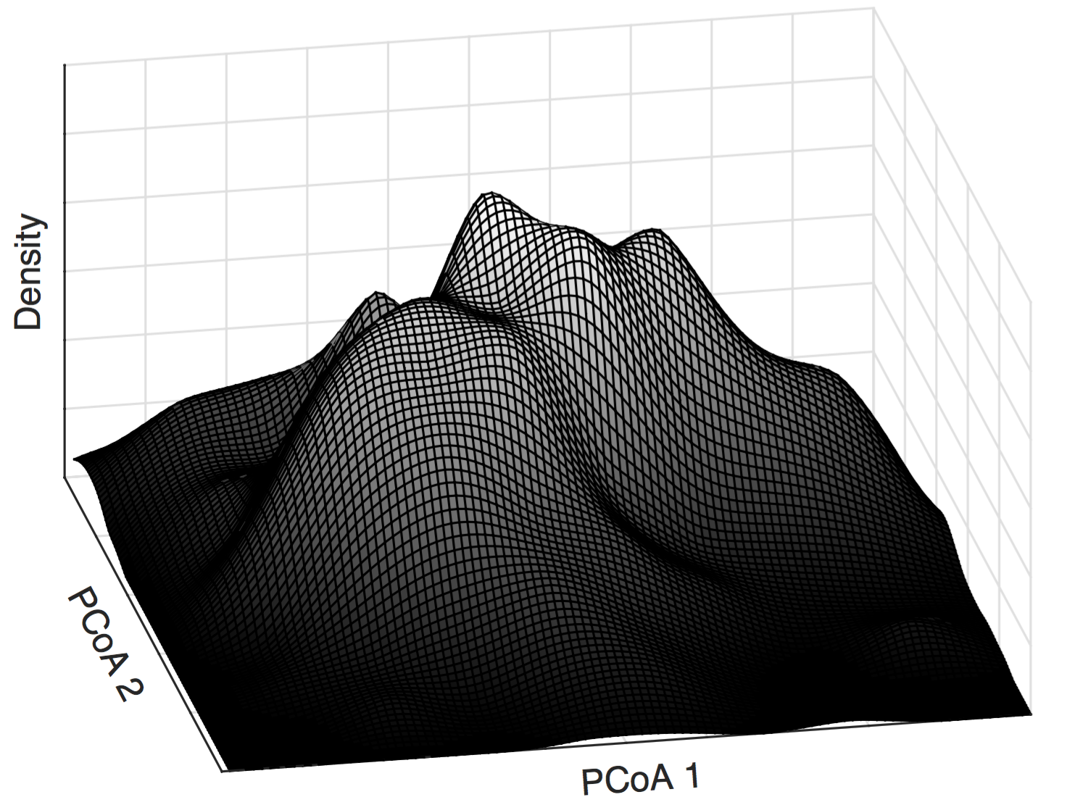
Karoline Faust
Lab of Microbial Systems Biology
KU Leuven
Nantes
2nd June 2017
On the origin of microbial community types
Didier Gonze, Leo Lahti, Jeroen Raes, Karoline Faust

Slide 2
Microbial abundance data
Example: Flemish Gut Flora Project (1,106 samples)
Bar plot of 40 randomly selected samples:
Falony, Joossens, Vieira-Silva, Wang, Darzi, Faust et al. Population-level analysis of gut microbiome variation. Science 352:560-564 (2016).

Slide 3
Microbial abundance data
How are people distributed in gut microbial community space?
3rd dimension: density (how many samples are located in a given area of the community space)
Microbial community space: Principal Coordinates Analysis
with Bray Curtis dissimilarity

Slide 4

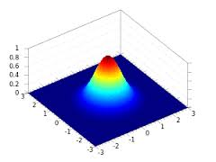
Community landscape shapes
Landscape is not flat: not all community compositions are equally likely
Landscape does not have a single peak: there is not a single preferred composition
Why do we observe more than one peak in the community landscape? Why are there alternative community configurations (clusters/types)?

Slide 5
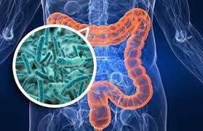
Classical example: enterotypes
Clustering gut microbial abundance data from 33 individuals
Marker genera for each cluster (drivers): Bacteroides, Ruminococcus and Prevotella
Arumugam, Raes et al. Enterotypes of the human gut microbiome (2011) Nature 473, 174-180.

Slide 6
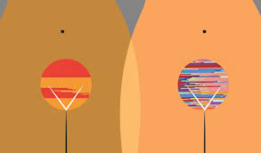
Another example: vaginal types
Five community types detected in 396 women by clustering:
Lactobacillus iners dominated
Lactobacillus crispatus dominated
Lactobacillus gasseri dominated
Lactobacillus jensenii dominated
Mixed (lower proportions of lactic acid bacteria and higher proportions of other anaerobic species)
Ravel et al. (2011) Vaginal microbiome of reproductive-age women PNAS 108, 4680-4687.

Slide 7
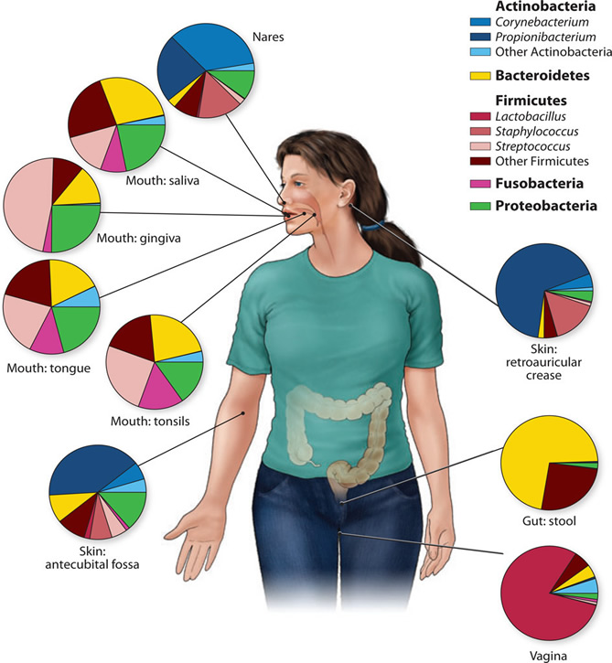

Other examples of community types
242 healthy individuals sampled in up to 18 body sites
Clusters found in the Human Microbiome Project data
Ding & Schloss (2014) Dynamics and associations of microbial community types across the human body Nature 509, 357-360.

Slide 8
What are community types?
A visualization bias (suggesting clusters where there are none)
A-C: Soil data, D-F: Simulations
Knights et al. (2014) Rethinking enterotypes Cell Host & Microbe, 433-437

Slide 9
What are community types?
Patterns due to gradients of dominant taxa (clusters disappear when dominant taxa are removed)
Gorvitovskaia et al. (2016) Interpreting Prevotella and Bacteroides as biomarkers of diet and lifestyle Microbiome 4:15
Notes:
Susan Holmes & Susan Huse
<number>

Slide 10
From clustering to mechanisms
“Enterotype debate” is about whether microbial abundance data is structured in distinct clusters, fuzzy (overlapping) clusters or gradients
We need to discuss instead the mechanisms generating the observed patterns
Three mechanisms behind alternative community types

Slide 11
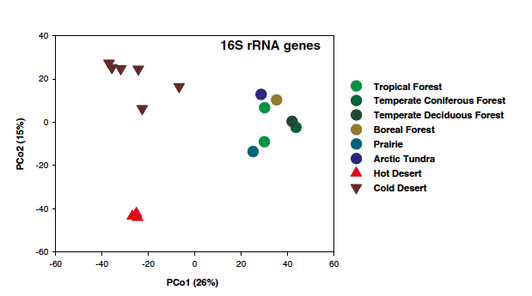
Mechanisms behind community types: 1. Environment
Community types are driven by environmental factors
Example: Composition of microbial soil communities
Biome
Fierer et al. (2012) Cross-biome metagenomic analyses of soil microbial communities and their functional attributes PNAS 109:52, 21390-21395.

Slide 12
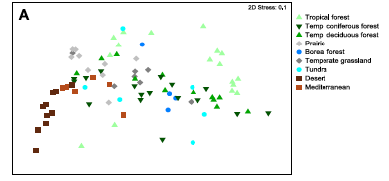
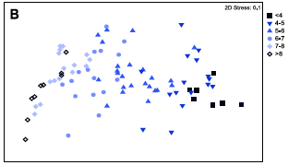
Mechanisms behind community types: 1. Environment
We may also observe gradients due to environmental factors
Example: Microbiota from soils with different pH
Nonmetric multidimensional scaling
Fierer et al. (2009) Pyrosequencing-Based Assessment of Soil pH as a Predictor of Soil Bacterial Community Structure at the Continental Scale Applied And Environmental Microbiology 75:15, 5111-5120.

Slide 13
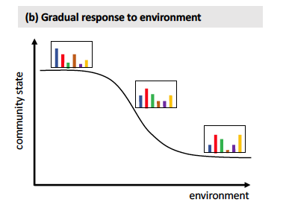
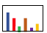
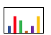
Mechanisms behind community types: 1. Environment
Community response can be gradual or abrupt, resulting in gradients or clusters
Gradual response to environment
Abrupt response to environment
Transitional community
environment
Gradient
Cluster

Slide 14
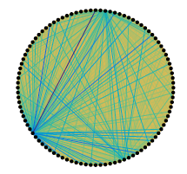
Mechanisms behind community types: 2. Heterogeneous interaction strengths
Community network
Black dots: community members
Edge thickness: interaction strengths
Gibson et al. (2016) “On the Origins and Control of Community Types in the Human Microbiome” PLoS Computational Biology 12(2):e1004688

Slide 15
Generalized Lotka-Volterra model
The species network = interaction matrix A (community matrix)
Entries in A = interaction strengths
Diagonal = intra-species competition
The vector of species abundances x changes as a function of the species’ growth rates b and their interaction matrix A

Slide 16
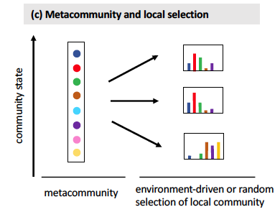
Mechanism 2: Simulation of community dynamics
Steady state abundances in local communities
Metacommunity and local selection
Simulation of local community dynamics with generalized Lotka Volterra
Gibson et al. (2016) “On the Origins and Control of Community Types in the Human Microbiome” PLoS Computational Biology 12(2):e1004688

Slide 17
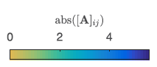
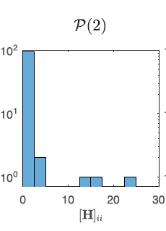
Mechanism 2: Manipulation of interaction strength heterogeneity
Heterogeneity
Interaction strengths
Network structure
A: Interaction matrix of metacommunity
N: Matrix of interaction strengths (normally distributed)
H: Diagonal matrix of heterogeneity (distributed according to power law with exponent -α)
G: Matrix of the ecological network (presence/absence)
s: Scaling factor (between 0 and 1)
o = Hadamard product (element-wise matrix multiplication)
Notes:
Diagonal values of A: -1
<number>

Slide 18
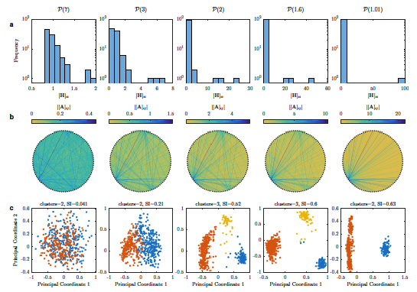
Mechanism 2: Formation of clusters or gradients depends on heterogeneity
Power law distribution defining extent of heterogeneity
Visualization of global interaction matrix A
PCoA plot of local communities
Gradient
Cluster

Slide 19
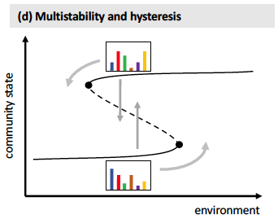
Mechanisms behind community types: 3. Multi-stability
Multi-stability and hysteresis
Tipping point 1
Tipping point 2

Slide 20
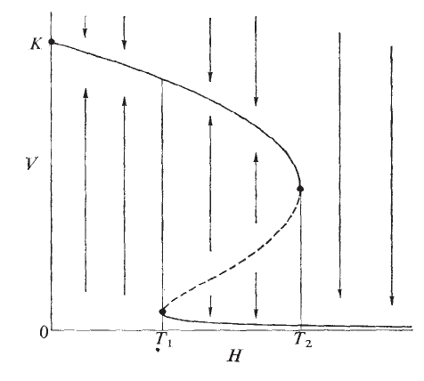
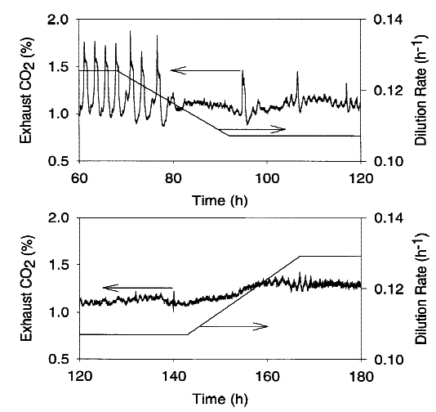
Mechanisms behind community types: 3. Multi-stability
Multi-stability has a long history in ecology...
... and has been observed experimentally
Stable states of vegetation biomass (V) as a function of stocking density H
May (1977) Nature 269, 471-477, Figure 3
Oscillating and non-oscillating growth of yeast in continuous culture
Zamamiri et al. (2001) Biotechnology and Bioengineering 75, 305-312, Figure 3

Slide 21
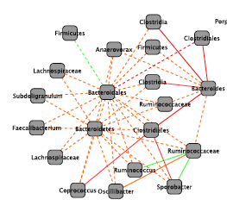
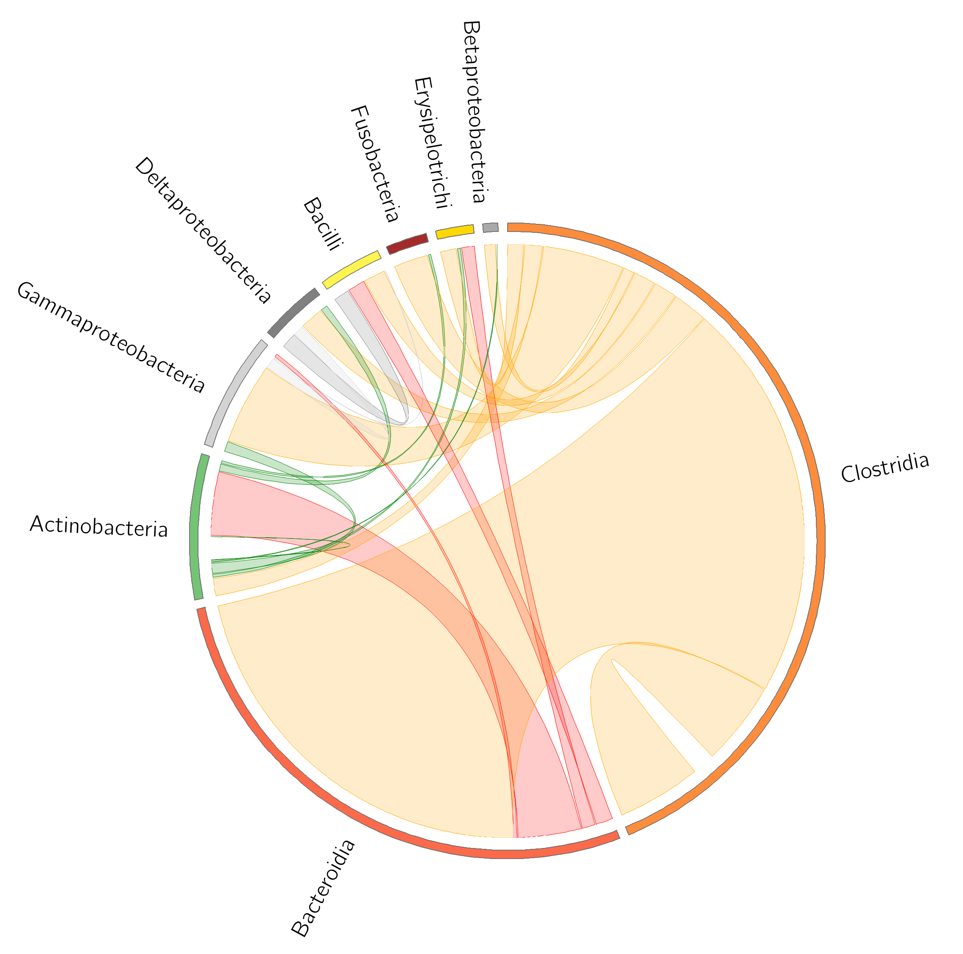
Ingredients for multi-stable microbial communities
Thomas’ conjecture: multi-stability requires a positive circuit
Two mutually inhibiting species form a positive circuit (-1*-1=1)
Motivation: enterotype driver genera often found to be negatively linked in gut networks
Sub-network for HMP stool data set
Negative links between classes in stool samples of subject A (David et al. Genome Biology 2014)
Rumino-coccus
Thomas & D’Ari. (1990) “Biological Feedback” CRC Press.

Slide 22
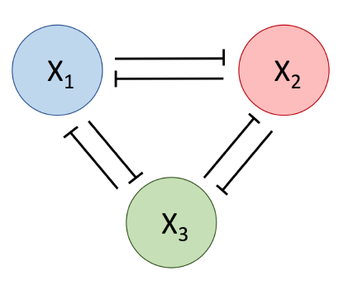
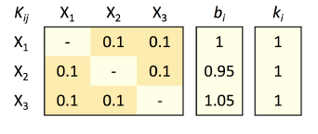
Multi-stable microbial communities: a toy model
Model parameters
Mutual inhibition
Community model
Taxon abundances
Growth rate
Death rate
Inhibition function
Inhibition coefficients
Hill coefficients
N: Species number

Slide 23
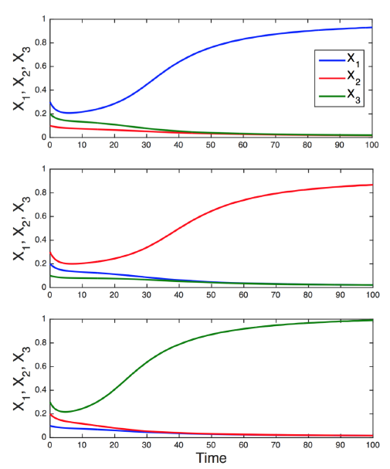
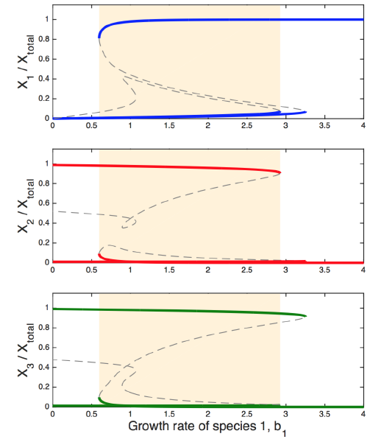
Multi-stable microbial communities: a toy model
Abundance over time
Bifurcation diagrams

Slide 24
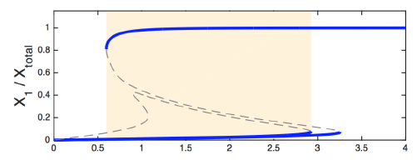
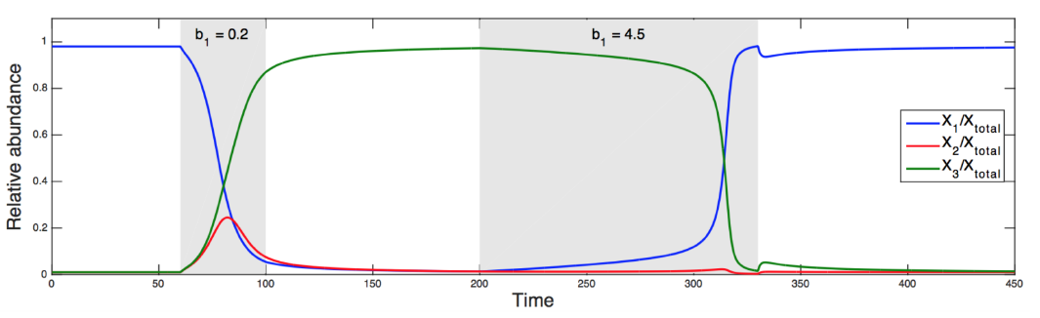
Toy model: journey through the bifurcation diagram (hysteresis)
Relative abundance X1
Initial growth rate of X1=1
Growth rate X1
Decrease growth rate of X1 below a tipping point
Increase growth rate of X1 above another tipping point
Growth rate of X1 is back to 1
Growth rate of X1 is back to 1

Slide 25
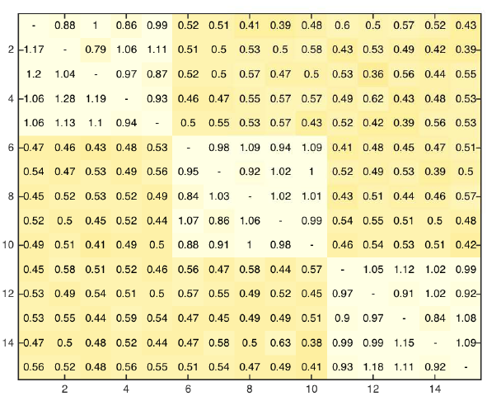
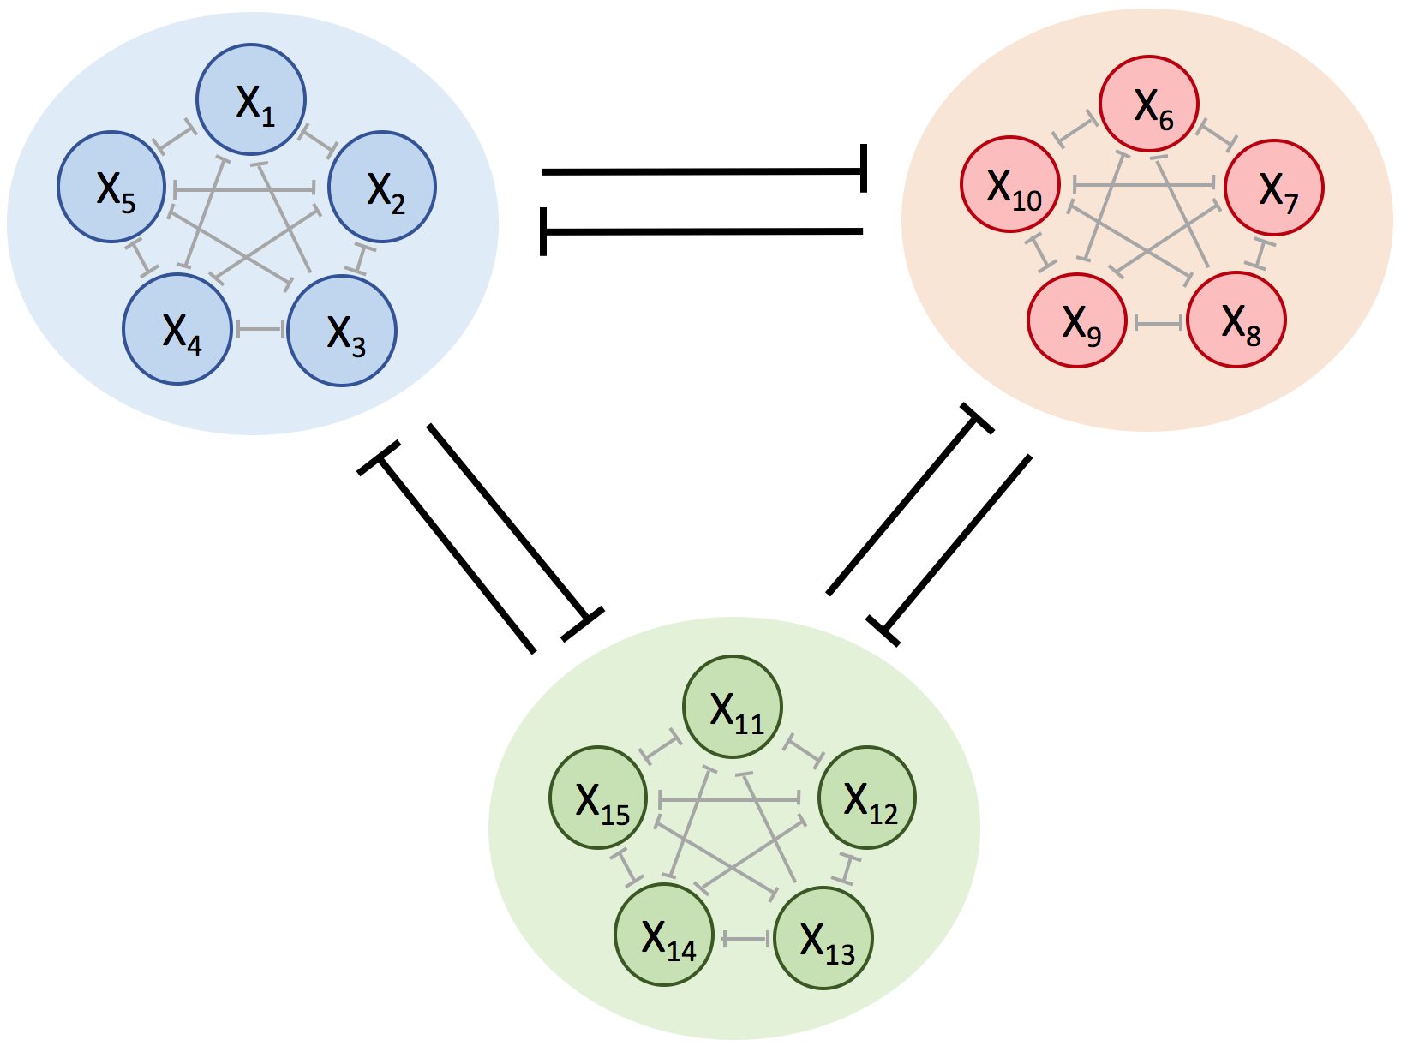
Multi-stable microbial communities: a proof-of-concept model
Inhibition matrix
Inhibition network (N=15)
Inter-group inhibition is stronger than intra-group inhibition (the smaller the stronger)
Species i
Species j

Slide 26
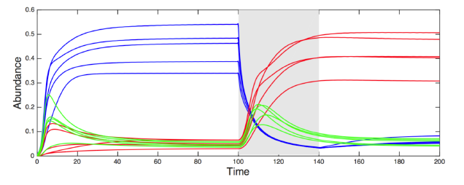
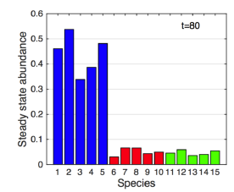
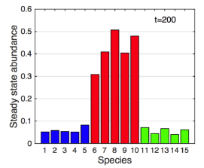
Proof-of-concept model generates multi-stable communities (hysteresis)
Growth rates of red species increased

Slide 27
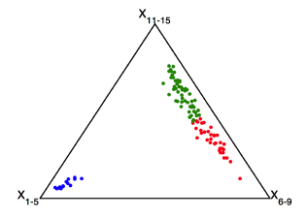
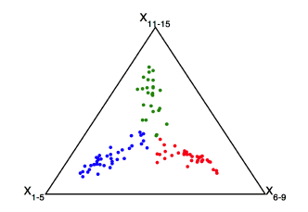
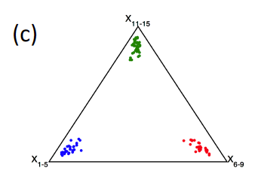
Multi-stable microbial communities form clusters or gradients
Samples are generated by slightly varying model parameters (growth rates and inhibition coefficients)
When inter-group inhibitions are weakened, gradients form
Ternary plots
Gradient
Cluster
Notes:
<number>

Slide 28
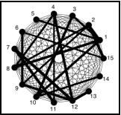
Proof-of-concept model without group structure
Heterogeneous inhibition coefficients are drawn randomly from a non-linear distribution (no predefined groups)
Notes:
I
<number>

Slide 29
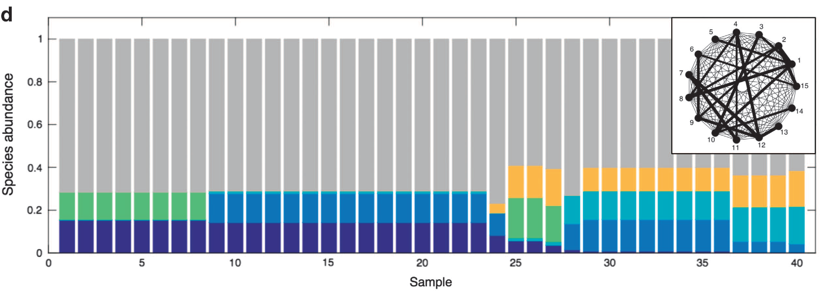
Proof-of-concept model without group structure forms clusters
Generate samples by simulating with varying initial abundances
Plot: Top five most strongly varying species in color and remaining species in gray
Clusters emerge

Slide 30
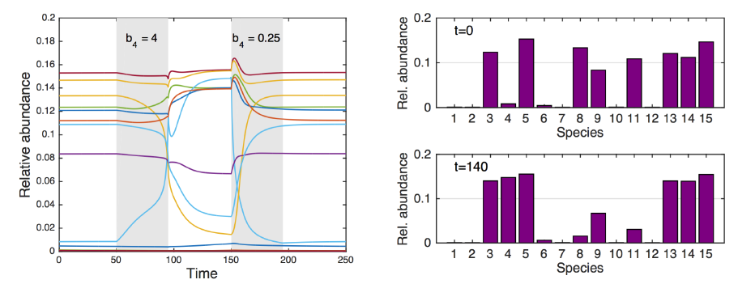
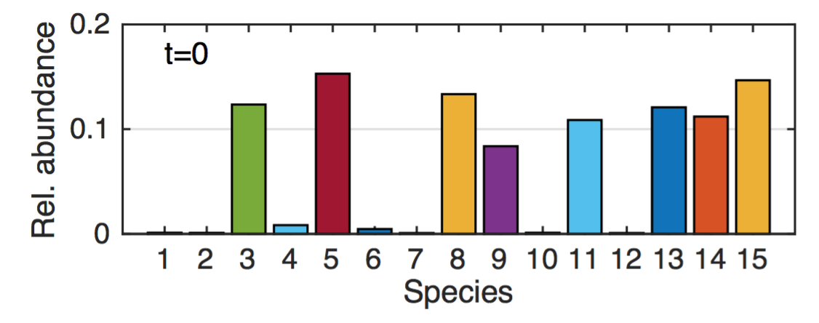
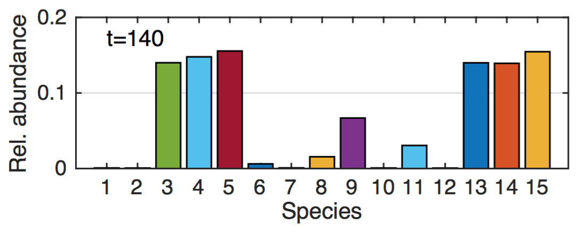
Proof-of-concept model without group structure shows hysteresis
Increasing growth rate of species 4 above tipping point
Decreasing growth rate of species 4 below another tipping point

Slide 31
What is the difference between Gibson’s mechanism and multi-stability?
Both rely on heterogeneous interaction strengths to generate alternative communities
But: in Gibson’s mechanism, different species sets lead to different community types, whereas in multi-stable communities, the same species generate different community types

Slide 32
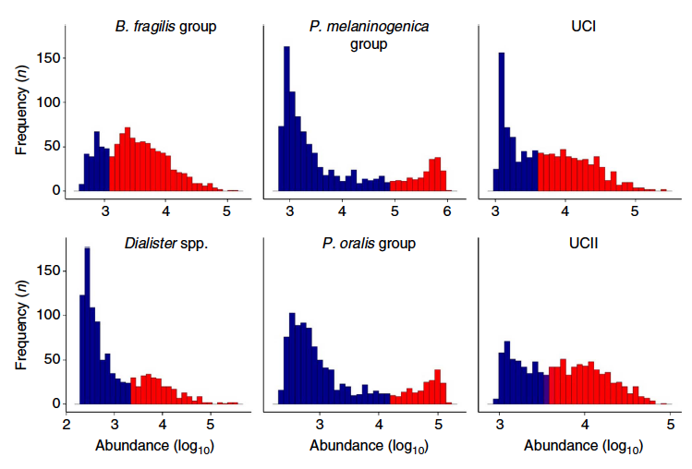
How do we recognize multi-stability?
Bimodality in abundance distributions across samples
HITChip gut data: 1,006 samples
Lahti et al. Tipping elements in the human intestinal ecosystem. Nature comm. 5:4344 (2014).

Slide 33
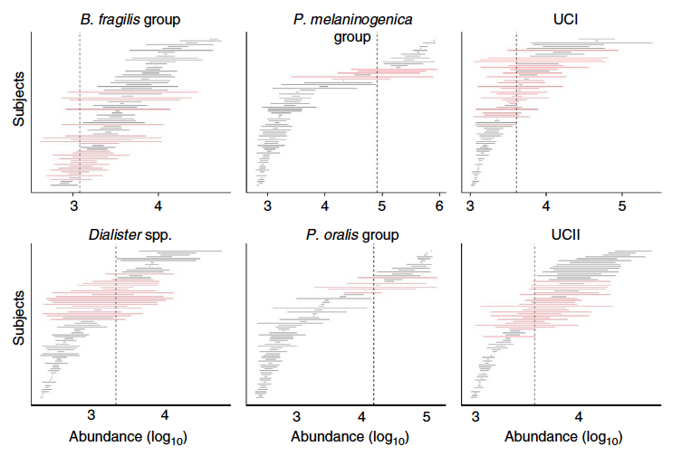
How do we recognize multi-stability?
Bimodality alone is not sufficient: abrupt response to environment can also generate bimodal distributions
Second criterion: large variation of abundance (state shift) around tipping point (requires at least a few time points)
Abrupt response to environment
Community state
environment
Lahti et al. Tipping elements in the human intestinal ecosystem. Nature comm. 5:4344 (2014).

Slide 34
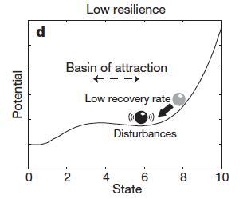
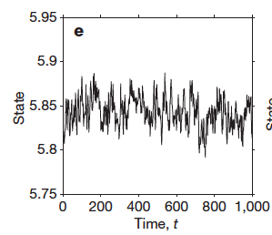
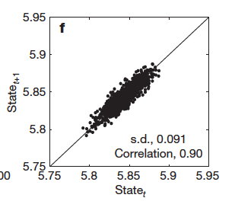
How do we recognize multi-stability?
Early warning signs
requires changing an environmental parameter or system variable and observing the effects over a long period of time
Near tipping point, recovery from perturbations slows down, resulting in a longer memory of perturbations
Time series properties: larger variance and higher correlation between community composition at subsequent time points (autocorrelation)
Scheffer et al. (2009) Early-warning signals for critical transitions Nature 461:53-59.

Slide 35
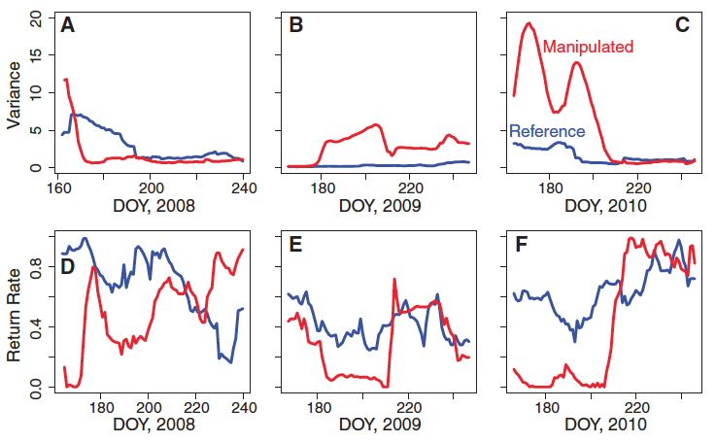
How do we recognize multi-stability?
Early warning signs example: in a lake manipulation experiment (top predators added over three years to one lake)
Food web change in manipulated lake preceded by early warning signs
Variance of daily chlorophyll concentrations
Autocorrelation of daily chlorophyll concentrations
Carpenter et al. (2011) Early Warnings of Regime Shifts: A Whole-Ecosystem Experiment. Science 332, 1079.

Slide 36
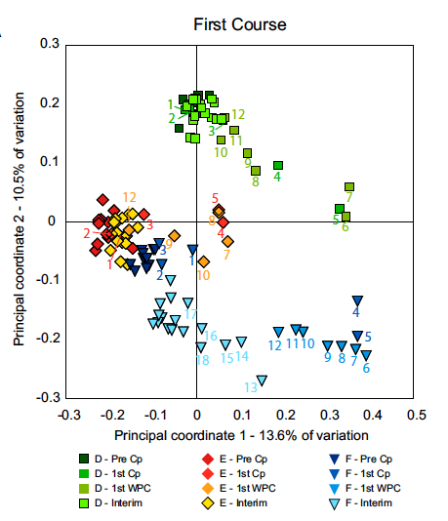
How do we recognize multi-stability?
Hysteresis
Apply a perturbation and check whether gut community returns to original state or not
three individuals (D, E, F), sampled multiple times before, during and after antibiotic treatment
Cp: antibiotic ciprofloxacin
Pre-Cp: before Cp treatment
1st Cp: first Cp treatment
1st WCP: first week after Cp treatment
Interim: time between first and second Cp treatment
Numbers: days since start of treatment
Gut microbiota for D and E returns to previous state, but not for F
Dethlefsen & Relman (2011) Incomplete recovery and individualized responses of the human distal gut microbiota to repeated antibiotic perturbation PNAS 108:4554-4561.

Slide 37



Implications of multi-stability
History matters: current differences in community composition may be due to past events rather than the environment
=> current differences in host life style do not necessarily explain community differences
Neutral community model: purely stochastic, interactions do not shape community dynamics
Multi-stability implies that community dynamics is not neutral, since species interactions are required for multi-stability
Perturbation
Time
Microbiome dissimilarity
Rosindell, J., Hubbell S.P. and Etienne R.S. (2011). The Unified Neutral Theory of Biodiversity and Biogeography at Age Ten. Trends in Ecology and Evolution 26 (7):340-348.

Slide 38
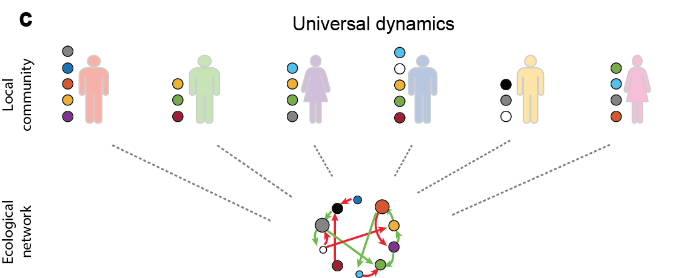
Implications of multi-stability
Bashan and colleagues proposed a method to probe universality of community dynamics
Dissimilarity-Overlap-Curve (DOC) method assumes that higher proportion of shared species (overlap) reduces dissimilarity of community composition
DOC method assumes that species governed by the same dynamics reach the same stable state, which is not true for multi-stability
Bashan et al. (2016) “Universality of human microbial dynamics” Nature 534:259-262.

Slide 39

Implications of interaction strength heterogeneity
A few strongly interacting species drive community types (in 2 mechanisms)
These species can act as levers to control the community type
Multi-stability: lever has to be pulled below/above tipping points to alter the community (lever species instead of keystone species)
Growth rate of species 4
Community type 1
Community type 2
Tipping points
low
high
Notes:
<number>

Slide 40
Summary
Community types: mechanism matters more than whether patterns represent gradients, fuzzy or distinct clusters
Mechanism 1: Community can respond gradually or abruptly to environmental change
Mechanism 2: Community types are generated by sampling species from a metacommunity with strongly heterogeneous interaction strengths (Gibson et al.)
Mechanism 3: Community types are generated with the same species through multi-stability
All three mechanisms can generate gradients or clusters depending on parameters

Slide 41

Open Questions
Can mechanisms behind alternative microbial community types act in combination?
Are there other mechanisms behind alternative community types?

Slide 42
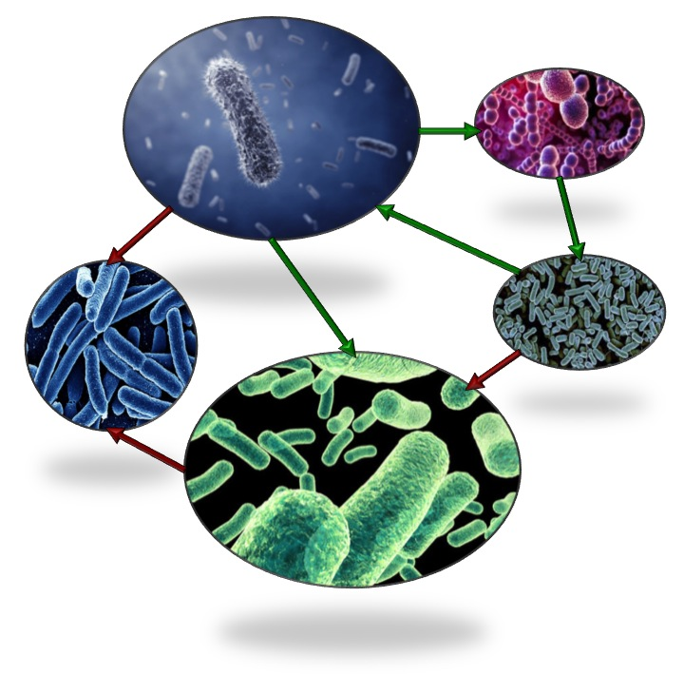
Summer school
Summer school on ecological network inference and analysis (11th -13th September 2017)
Co-organizers: Leo Lahti (Raes lab, KU Leuven) & Didier Gonze (Unit of Theoretical Chronobiology, ULB)
Presenters include: Tim Poisot (University of Montreal), Katharine Coyte (Xavier lab, Memorial Sloan Kettering Cancer Center, New York), Jing Tang (Institute for Molecular Medicine Finland) and others
http://tinyurl.com/econetschool
Registration still open

Slide 43
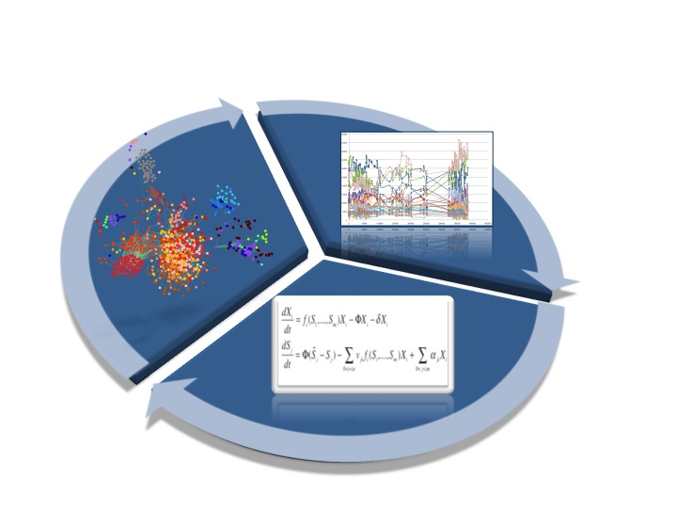

PhD position in Leuven
Application deadline: end of July 2017
http://tinyurl.com/MicrobialSysBio

Slide 44



Collaborators
Didier Gonze, ULB, Brussels
Jeroen Raes, KU Leuven/VIB
Leo Lahti, KU Leuven/University of Turku

Slide 45

Thank you!

Slide 46

Appendix: The landscape view of community types
Alternative community types
Low probability
High probability

Slide 47
Appendix: Prevotella versus Bacteroides in Flemish Gut Flora Data
Prevotella
Bacteroides
Pearson’s r: -0.36
P-value: < 2.2e-16

